Slide 1
In order to participate in the study you must first complete a short sorting process. You will now be presented with several questions in which you will need to mark your preferences. According to these preferences, you will be assigned to one of two groups: we will refer to these groups as YOUR GROUP and the OTHER GROUP.
Previous studies show that there is a 50%-50% divide based on these preferences.

Slide 2
You have been assigned to one of the groups.
We will refer to these groups as
YOUR GROUP and THE OTHER GROUP.
Next is the explanation of the actual study.

Slide 3
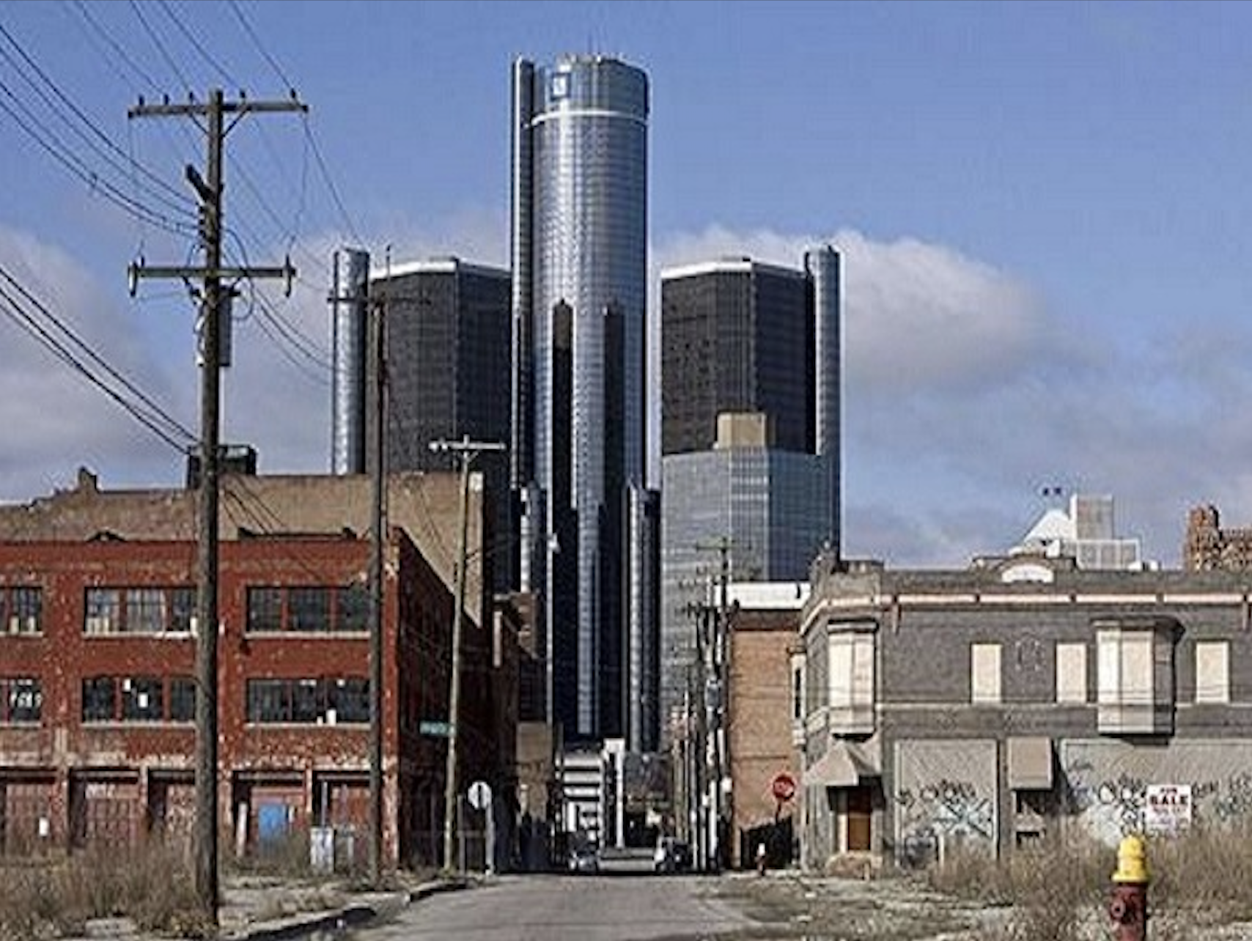
In this study you will first observe a picture on a scree. The pictures will be more emotional than the picture below which is used for training purposes. The picture will appear on the screen for 5 seconds.

Slide 4
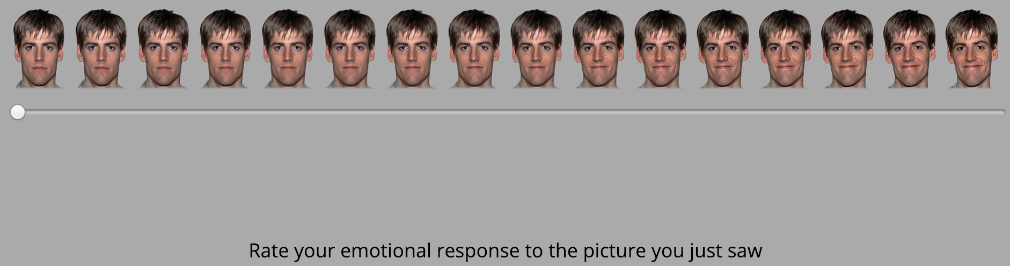
​Following the picture, a scale will appear in the middle of the screen. By moving the scale, you are asked to rate your emotional response to the picture you just saw. The left side representing not emotions at all, and the right side representing a lot of negative emotion In order to rate your emotional response you need to move the scale and click on it. Once you click on the scale, it will move to the next page.

Slide 5
Remember, the goal here is to click one point on the scale that reflects YOUR EMOTIONAL RESPONSE to the picture you just saw.

Slide 6
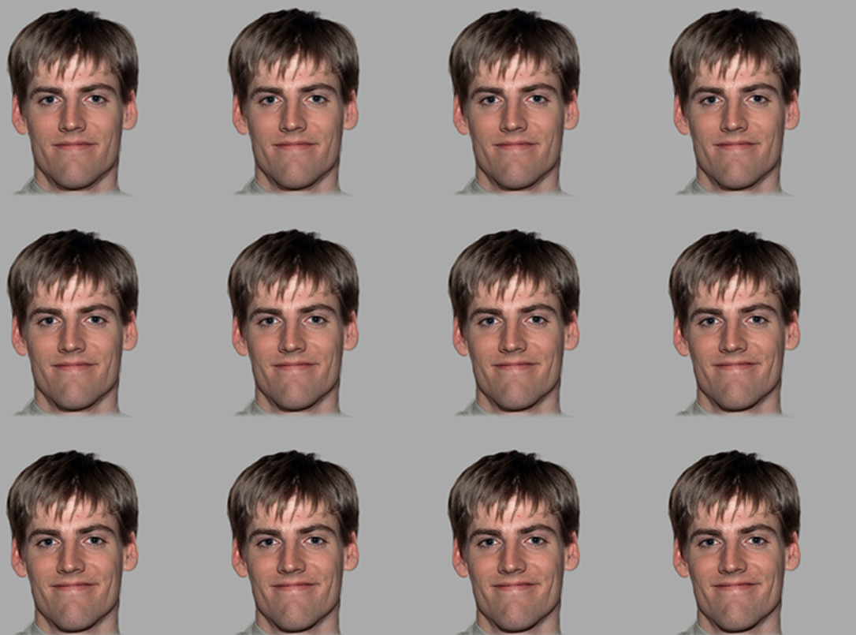
Following your rating you will see ratings of 12 other participants to the same picture.

Slide 7
Their ratings were either sampled from participants who were previously assigned to YOUR GROUP or participants who were assigned to the OTHER GROUP. These ratings will appear only for 1 second. In order to take all the ratings in, try to expand your attention to the four corners of the screen.

Slide 8

Following these pictures you will then asked to choose whether these 12 facial expression were taken from participants who were assigned to YOUR GROUP or from the OTHER GROUP. Use the mouse to choose the group from which these responses were taken?

Slide 9
Next you will conduct a short practice run for the task.

Slide 10
Thank you for completing the practice stage.
Remember – the goal was to rate YOUR EMOTIONAL RESPONSE of the picture you just saw and then decide if the 12 other ratings were taken from participants in your group or the other group.
In the following section you will complete the actual study, which consists of 50 trials. The task should take 5 minutes, more or less.
Click ‘Continue’ to begin the actual task.

Slide 11
You've completed the task.
Thank you for your participation.
The next section is a short survey
(up to 5 min).

